Slide 1

Payment Processing
Vikas Bodani
May 9, 2012

Slide 2

Agenda
Payments: why, what?
Integration with payment gateways
Parallel payment processing

Slide 3
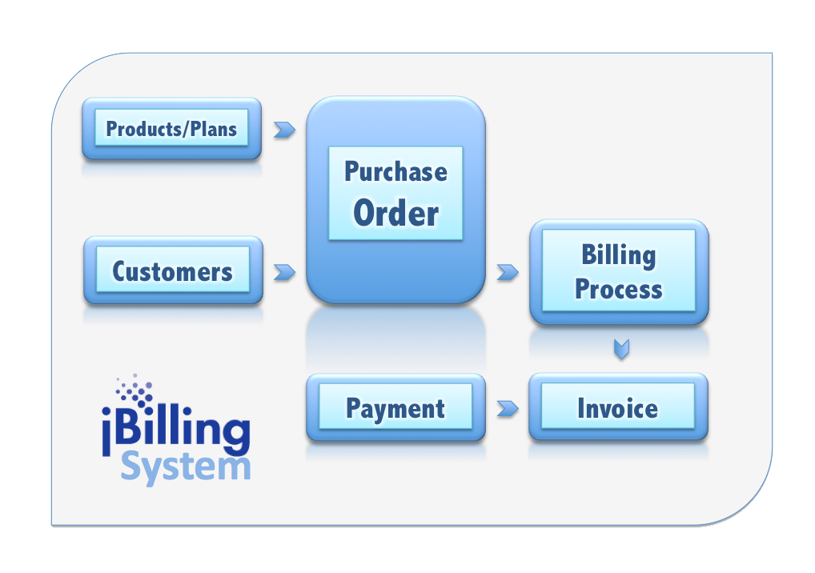
Payments
Payments are the last step of the main billing workflow

Slide 4
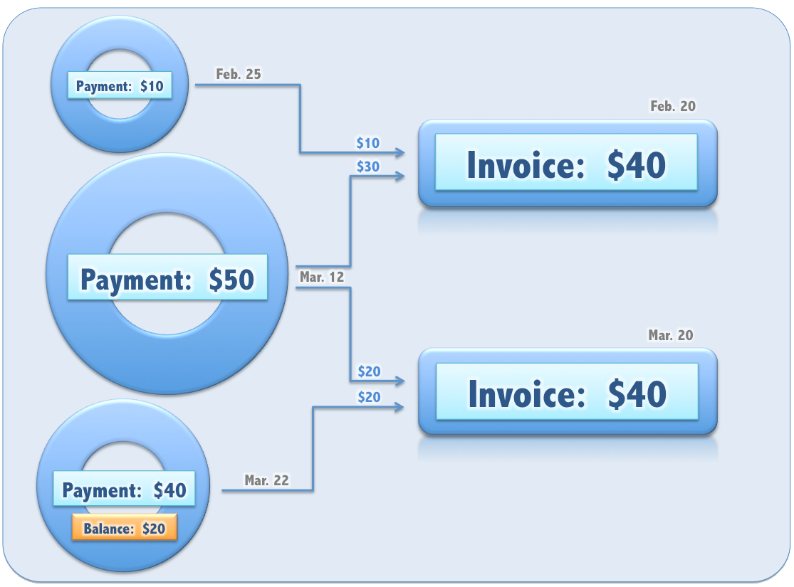
Payments
Payments have a many-to-many relationship with invoices

Slide 5
Background
jBilling is not standalone billing system
integrated application with many interfaces
plug-in architecture
Payment plugins extend the payment interface
Step-by-step instructions on how to create a new payment processing plug-in are in the ‘jBilling Extension Guide’

Slide 6
Payment Processor Requirements
support many payment options (credit card, ach or direct debit)
provide fail-over
support for custom protocols for each gateway
ease of use/configuration
Abstract classes that provide default implementation

Slide 7
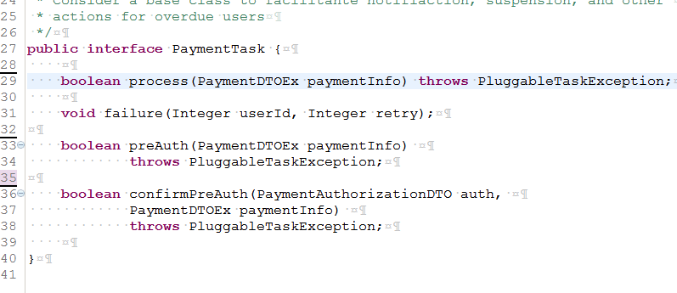
Interface PaymentTask

Slide 8
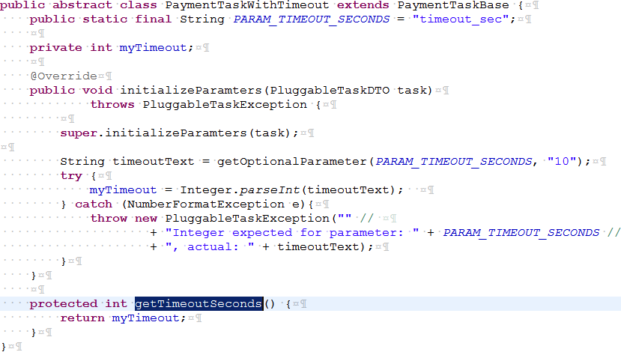
Rules for implementing a Payment Processor
Implement a time-out
seconds or mili-seconds, if timeout, gateway unavailable

Slide 9
Rule 2 (continued)
Use Parameters
gateway url, key, username, password etc

Slide 10
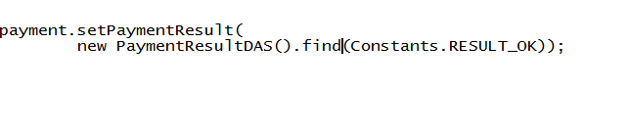
Rule 3 (continued)
Update the payment object with the result
Constants.ok constants.fail constants.unavailable

Slide 11
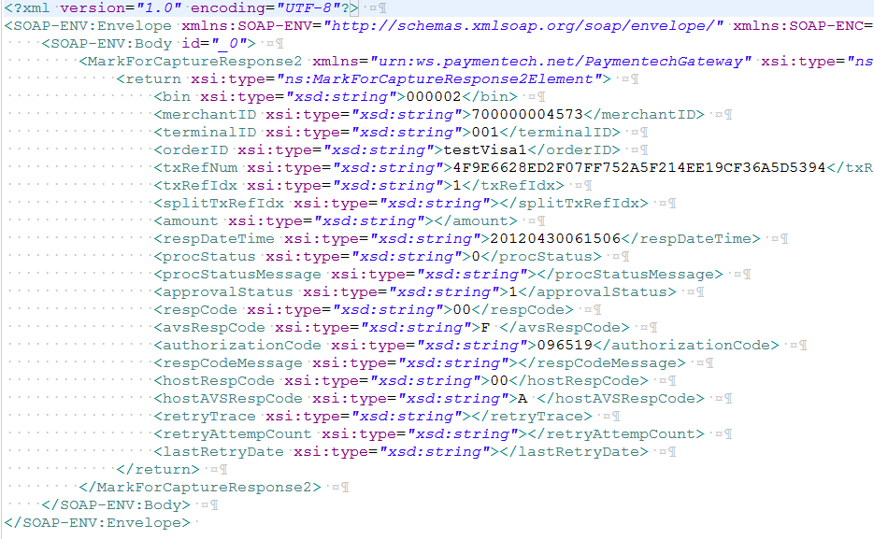
Rule 4 (continued)
Parse the processor result as paymentauthorizationDto

Slide 12
Rule 5 (continued)
Return true or false
As a rule, always return false
Return true only if the gateway is unavailable
This gives a chance for the other processors to be called to process the payment

Slide 13
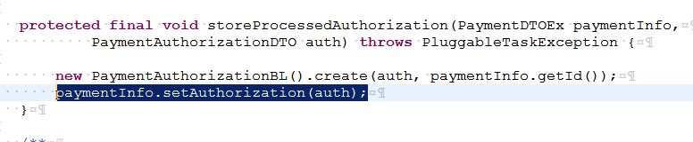
Rule 6-7 (continued)
A- Add authorization result to the payment
B -Create the auth record in the database

Slide 14
Payment Instrument
There is a plug-in type that has as a goal to find a payment method (instrument). Typically, find a valid credit card for a user
The return value of this plug-in will be the parameter for the payment processing plug-in
public interface PaymentInfoTask {
PaymentDTOEx getPaymentInfo(Integer userId) throws TaskException;
}

Slide 15
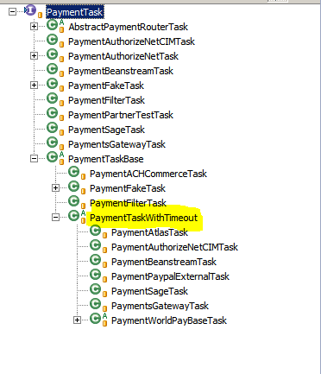
PLUGINS TO INTEGRATE

Slide 16
Asynchronous processing
billing process should not wait for payment processing
allows running payments as a batch job
required when there are potentially large number of payments
gateways may or may not support concurrent requests
The processpaymentmdb calls billingprocesssessionbean.processpayment to process the payments

Slide 17
Asynchronous processing
The billing process should not ‘wait’ to get a payment processed (ideally, payment processing would be in a different batch).
When the time comes to process a payment, the billing process will post a message in a queue (BillingProcessSessionBean. emailAndPayment())
Using JMS with ActiveMQ, a message driven class will pick up the request: ProcessPaymentMDB.java
The configuration for JMS is all done with Spring: grails-app/conf/spring/resources.xml

